Slide 1
Ticketing System Classification Model
Kiran Kumar Patro

Slide 2
Domain and Problem Understanding
Identify the category and subcategory from the given description.
Target variables are category and sub-category.
Category has 5 values and sub-category has 20 values.

Slide 3
Data Preprocessing
There are missing values in the given data and we have removed all rows containing missing values.
Removal of stop words.
Tokenizing.
Train & Test splitting

Slide 4
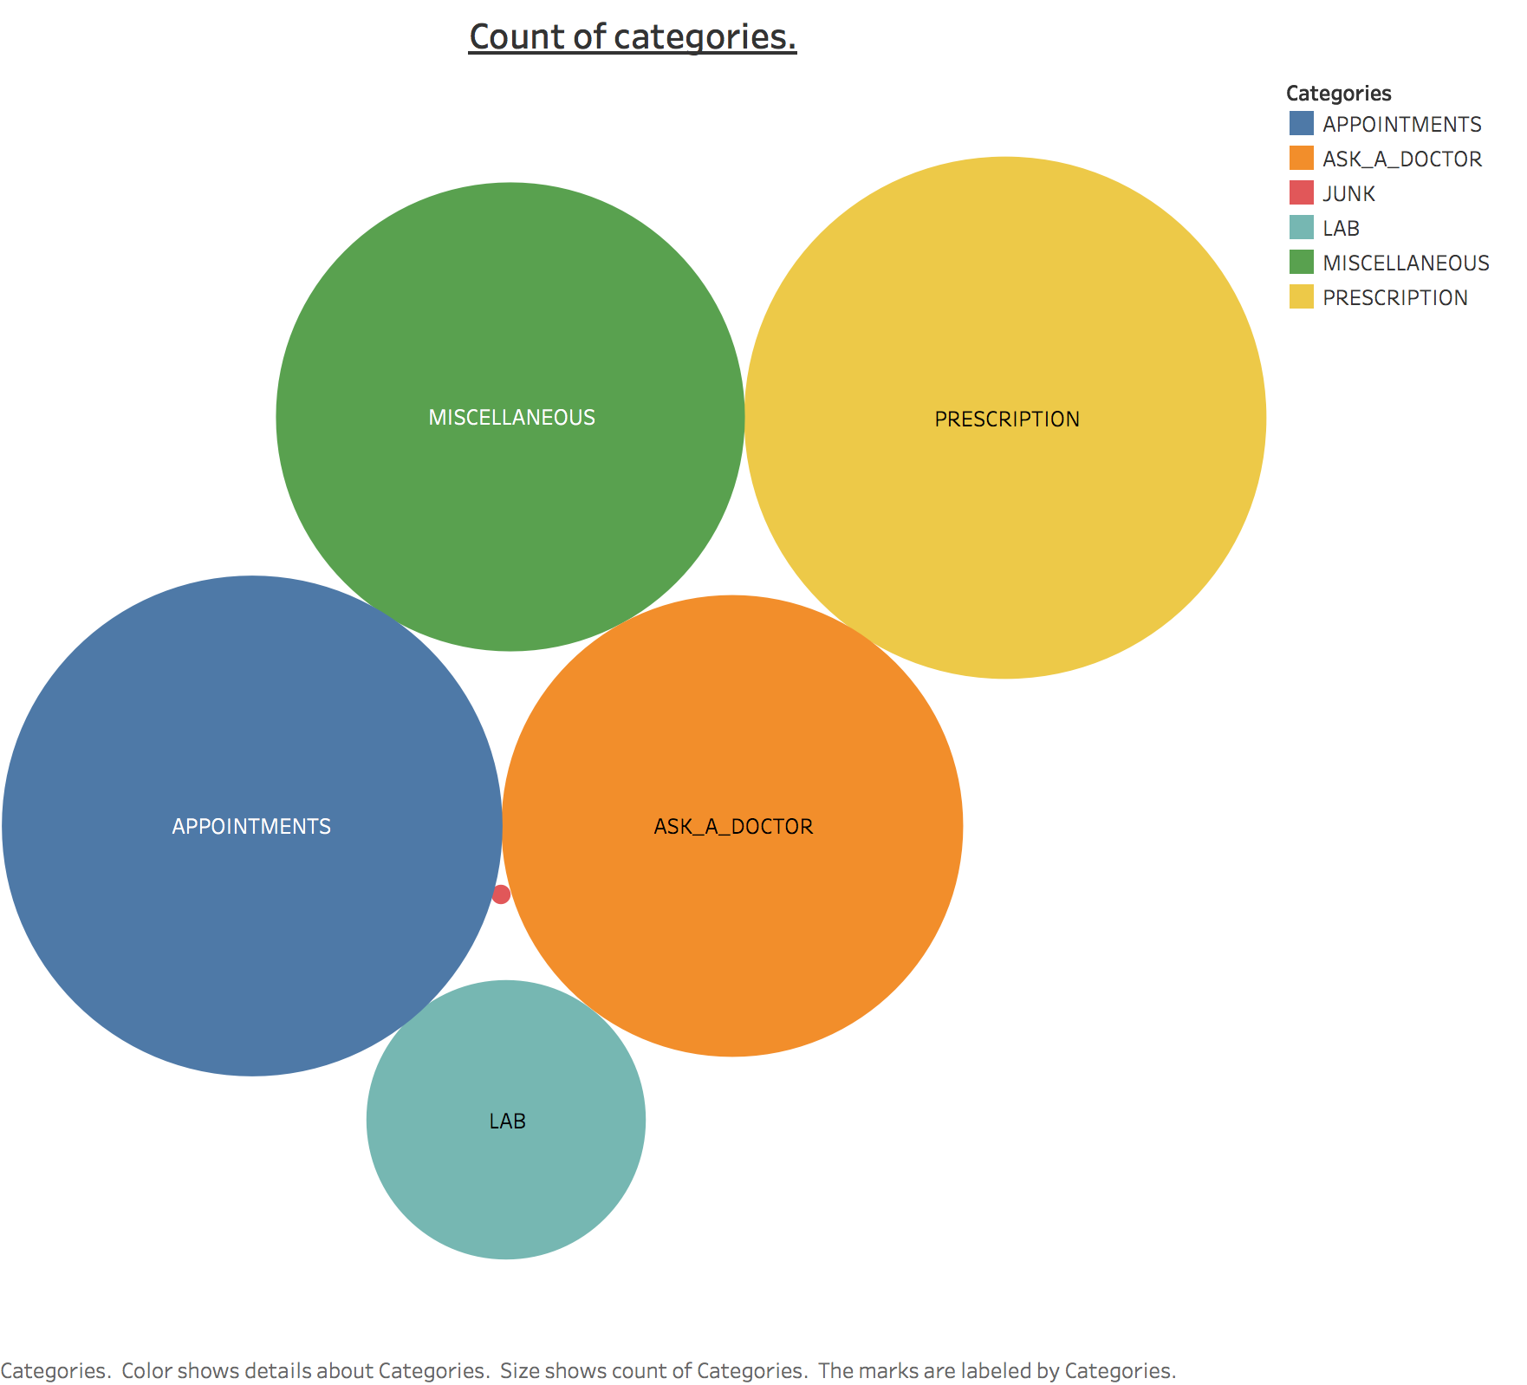
Data Exploration & Visualizations

Slide 5
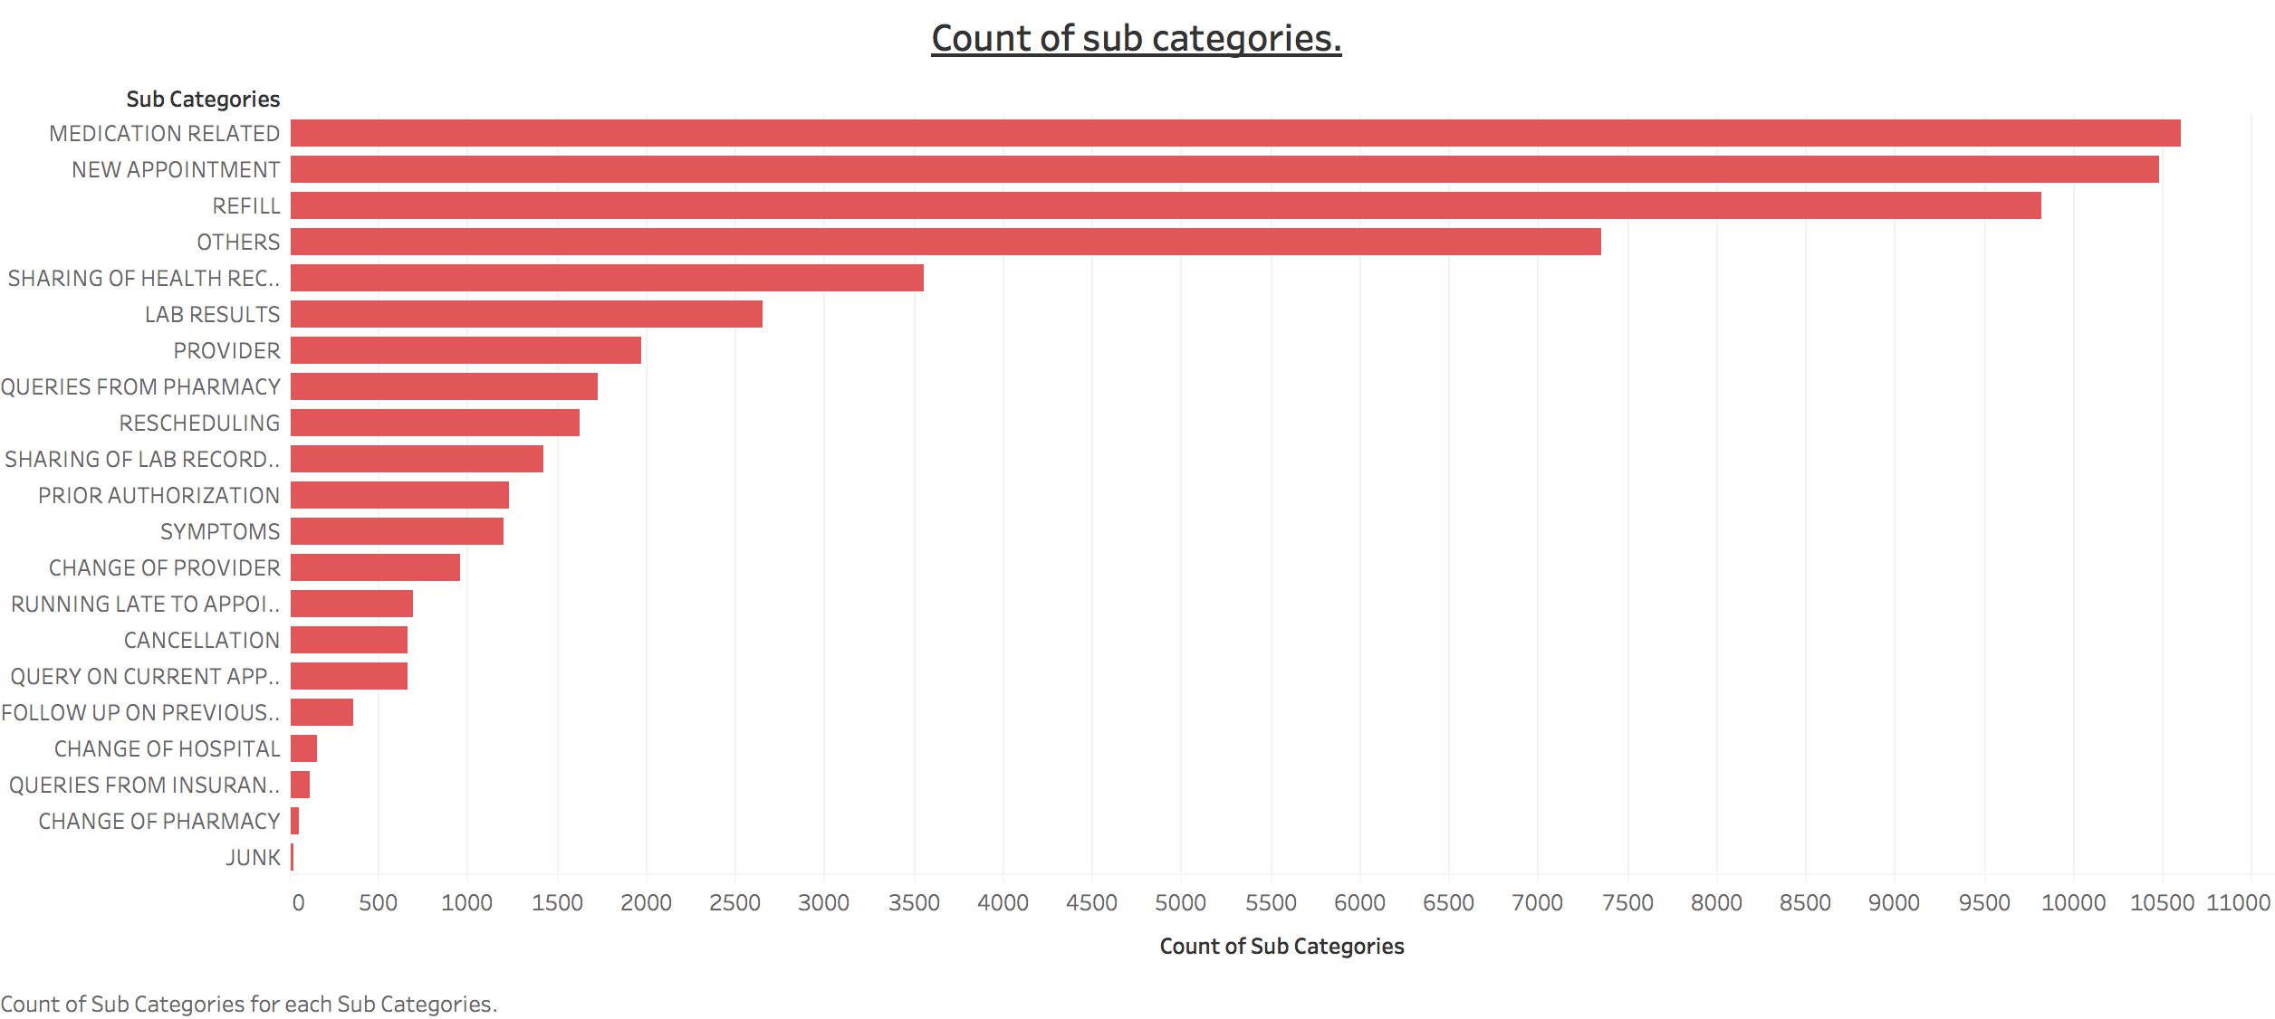
Data Exploration & Visualizations

Slide 6
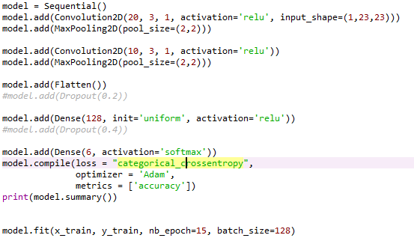
Model Building
Models tried:
CNN

Slide 7
CNN
CNN
Train Accuracy- 46.6 %
Test Accuracy- 43.7 %

Slide 8
Conclusion
We would have tried Transfer Learning and improve the present architecture.
We would have done for sub-categories.

